Slide 1

DS 2014 Final Project
Taipei U-bike

Slide 2
Revise
1. Revise NetSearch command.
2. Revise Name:
Inquire
StationReport
UbikeReport

Slide 3
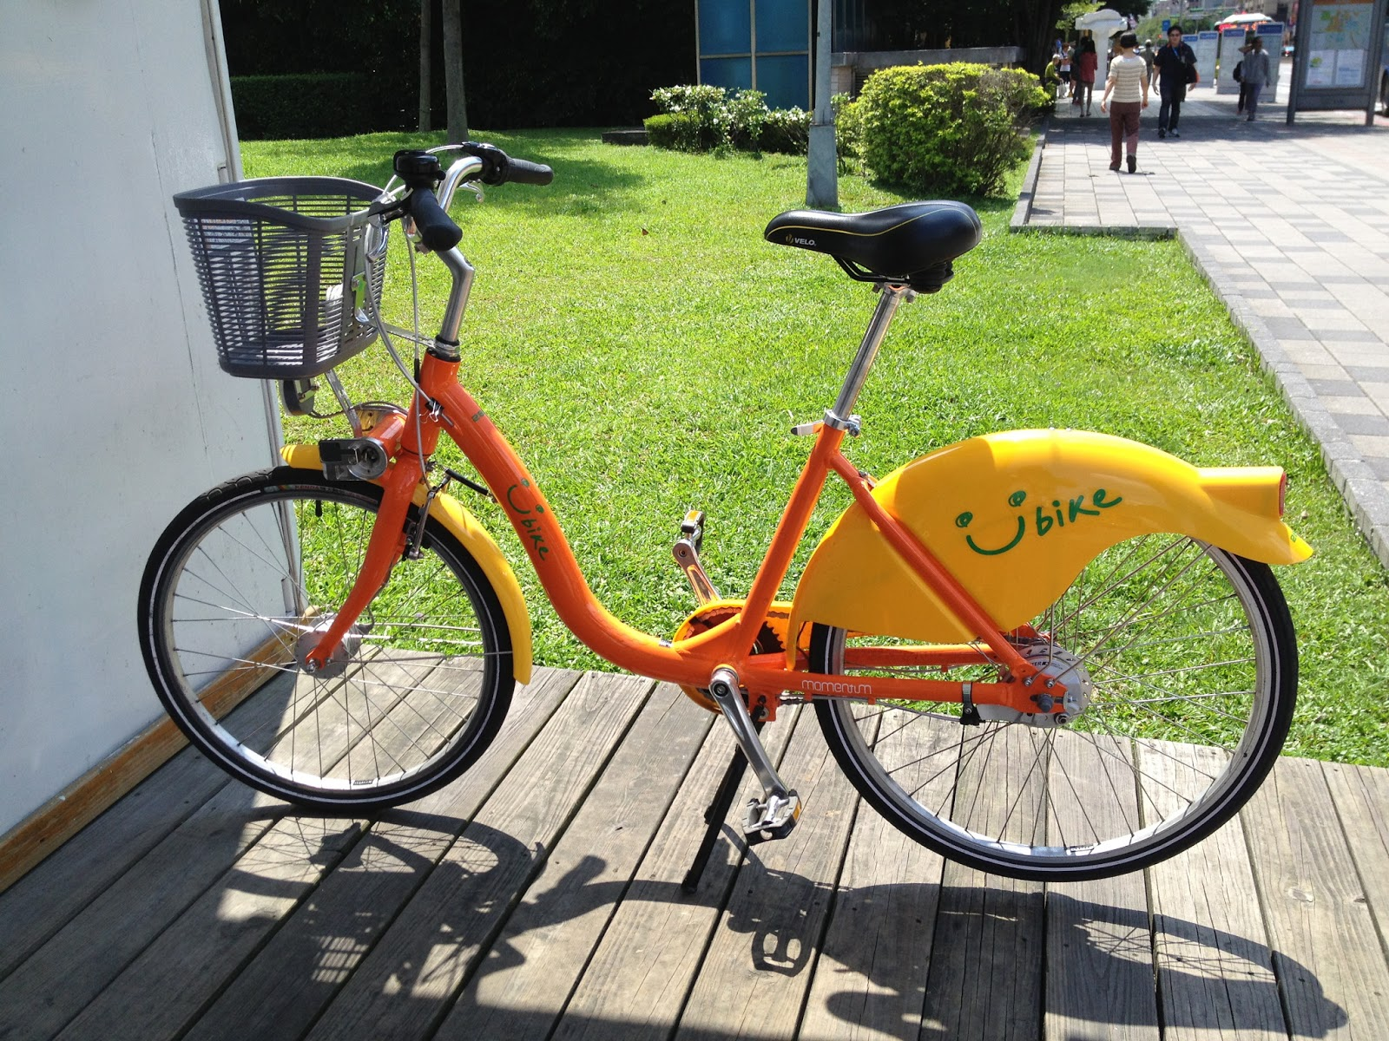
Taipei U-bike

Slide 4
Rental MRT Station
The Taipei U-bike are set in several MRT station and each has a rental MRT Station. We shall refer to these MRT station by their name.
12 stations:
They are Danshui(淡水), Hongshulin(紅樹林), Beitou(北投), Shilin(士林), Zhongshan(中山), Xinpu(新埔), Ximen(西門), Liuzhangli(六張犁), Muzha(木柵), Guting(古亭), Gongguan(公館) and Jingmei(景美).

Slide 5


Rental MRT Station
紅樹林
淡水
士林

Slide 6
Bike information
1.license number
2.mileage
3.class
(Electric, Lady, Road and Hybrid)
4.MRT station

Slide 7
License tag Hashing Table
In order to locate bikes quickly by only providing license tag (5 alphanumeric characters A..Z and 0..9), a Hashing Table is used.
The Hashing function is defined as follows:
1. ‘0’~’9’ correspond to 0-9 and
‘A’~’Z’ correspond to 10-35.
2. Let 5-character license tag be donated as x i.e., x[0] x[1]…x[4].
3. S(0) = x[0];
S(n) = S(n-1) * 31 + x[n];
11th to 18th bits (8-bit) of S(4) is used as the address to hashing table.
Moreover, overflow is handled by chaining.
x[0] | x[1] | x[2] | x[3] | x[4]
31^4 | 31^3 | 31^2 | 31^1 | 1

Slide 8

License tag Hashing Table
Ex:
If hash(bike1’s license tag) = 0, we push bike1 ptr to the hash table index 0

Slide 9
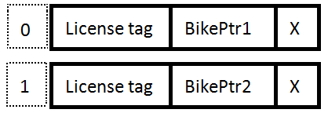
License tag Hashing Table
Ex:
If hash(bike1’s license tag) = 0, we push bike1 ptr to the hash table index 0
If hash(bike2’s license tag) = 1,we push bike2 ptr to the hash table index 1

Slide 10
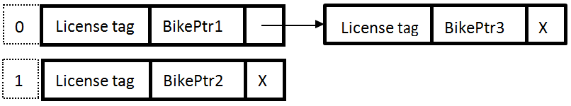
License tag Hashing Table
Ex:
If hash(bike1’s license tag) = 0, we push bikeptr1 to the hash table index 0
If hash(bike2’s license tag) = 1,we push bikeptr2 to the hash table index 1
If hash(bike3’s license tag) = 0, collision occurs and we solve it by chaining.

Slide 11
Bike class Heaps
For each MRT Station, we will keep five heaps (HElectric, HLady, HRoad, HHybrid, HRent) for four types (Electric, Lady, Road and Hybrid) of bikes and rented ones.
The ordering in these heaps is determined by the mileage of the bikes (largest value on the top of heap).
5 heaps
HElectric
HLady
HRoad
HHybrid
HRent

Slide 12
Bike class
Five heaps
Electric
mileage
Lady
Road
9
7
5
Hybrid
Rent
4
2
1

Slide 13
Bike class
EX: rent 1 electric bike
Electric
Lady
Road
9
7
5
Hybrid
Rent
4
2
1

Slide 14
Bike class
EX: rent 1 electric bike
Electric
Lady
Road
7
4
5
Hybrid
Rent
1
2
9

Slide 15
Bike rental charges shortest path distance
Bike rental charges are classified under two ranges:
Discount and Original
Class Electric - $30/mile and $40/mile
Class Lady - $25/mile and $30/mile
Class Road - $15/mile and $20/mile
Class Hybrid - $20/mile and $25/mile
We offer a discount to those who drive on shortest paths. The cost of mileages that used over shortest path distance are calculated with original charge.

Slide 16
Bike rental charges
return
Start
紅樹林
淡水
8
if (miles > 8)
Original
else
Discount
士林

Slide 17
Implement the following C/C++ subroutines:
NewBike
SearchBike
JunkBikePtr
TransBikePtr
RentBikePtr
Returns
Inquire
StationReport
UbikeReport
NetSearch
Notes:
NewBike ( License, Mileage , Class, Station);
SearchBike ( LicenseType LIC);
JunkBikePtr (BikePtr Bike);
TransBikePtr (StationType STA, BikePtr Bike);
RentBikePtr (StationType STA, BikePtr Bike, DateType Date);
Returns (StationType STA, BikePtr Bike, int ReturnMile)
INQUIRE (LicenseType LIC);
STAREP (StationType STA);
COMPREP();
NetSearch(StationType STA, DateType StartDate, DateType EndDate);

Slide 18
Short Announcement
You are required to team up for the final project (2 people)

